Slide 1

مرحله تکمیل موافقتنامه
ارزیابی عملکرد کارکنان سال 1405

Slide 2


Slide 3
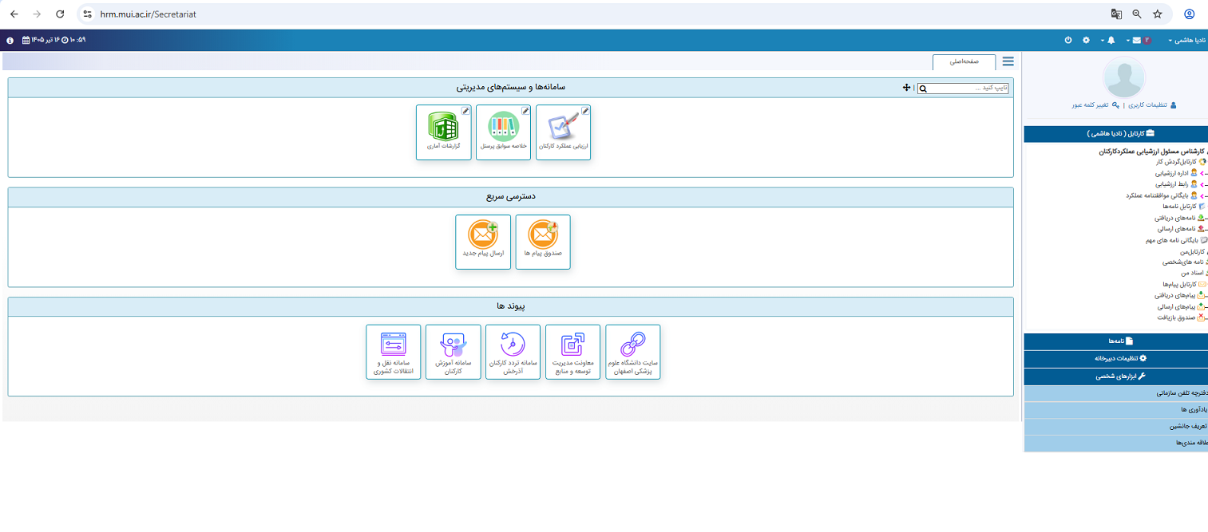
وارد سامانه ارزشیابی و سپس وارد صفحه" ارزیابی عملکرد کارکنان" شوید.

Slide 4
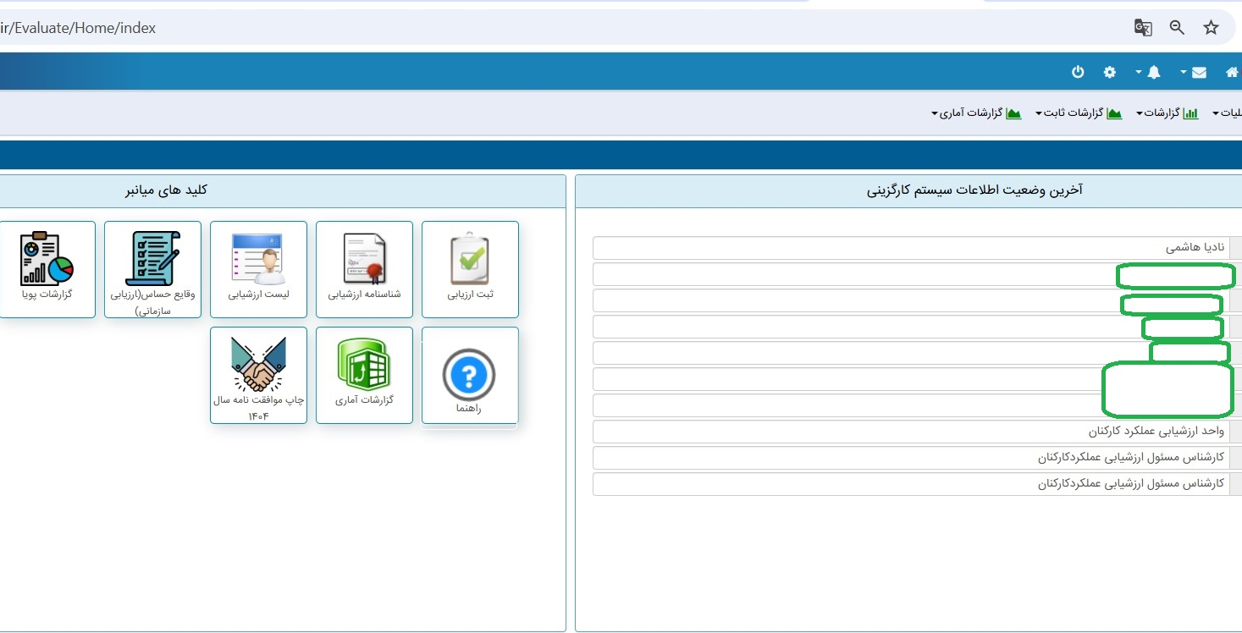

گزینه" ثبت ارزیابی " را انتخاب نمایید.
You can simply impress your audience and add a unique zing and appeal to your Presentations. Easy to change colors, photos and Text. Get a modern PowerPoint Presentation that is beautifully designed. You can simply impress your audience and add a unique zing and appeal to your Presentations. Easy to change colors, photos and Text. Get a modern PowerPoint Presentation that is beautifully designed.
Modern Portfolio Presentation

Slide 5
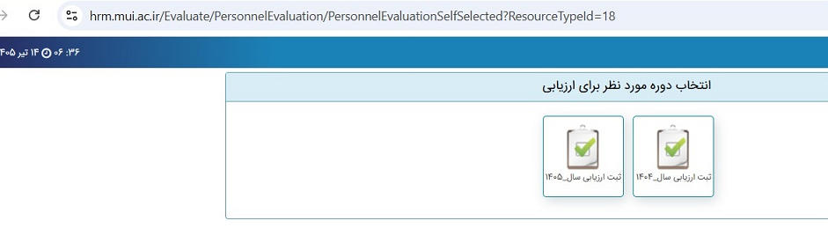
گزینه" ثبت ارزیابی سال 1405 " را
انتخاب نمایید.
You can simply impress your audience and add a unique zing and appeal to your Presentations. Easy to change colors, photos and Text. Get a modern PowerPoint Presentation that is beautifully designed. You can simply impress your audience and add a unique zing and appeal to your Presentations. Easy to change colors, photos and Text. Get a modern PowerPoint Presentation that is beautifully designed.

Slide 6
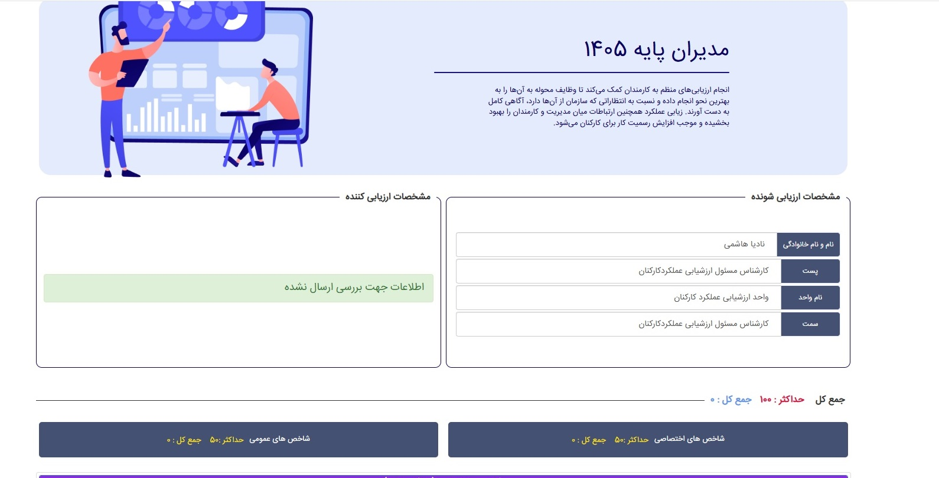
فرم ارزیابی سال 1405 مشاهده می شود.
به نوع فرم، سمت و تطابق نوع فرم با سمت توجه شود.
You can simply impress your audience and add a unique zing and appeal to your Presentations. Easy to change colors, photos and Text. Get a modern PowerPoint Presentation that is beautifully designed. You can simply impress your audience and add a unique zing and appeal to your Presentations. Easy to change colors, photos and Text. Get a modern PowerPoint Presentation that is beautifully designed.
Modern Portfolio Presentation

Slide 7
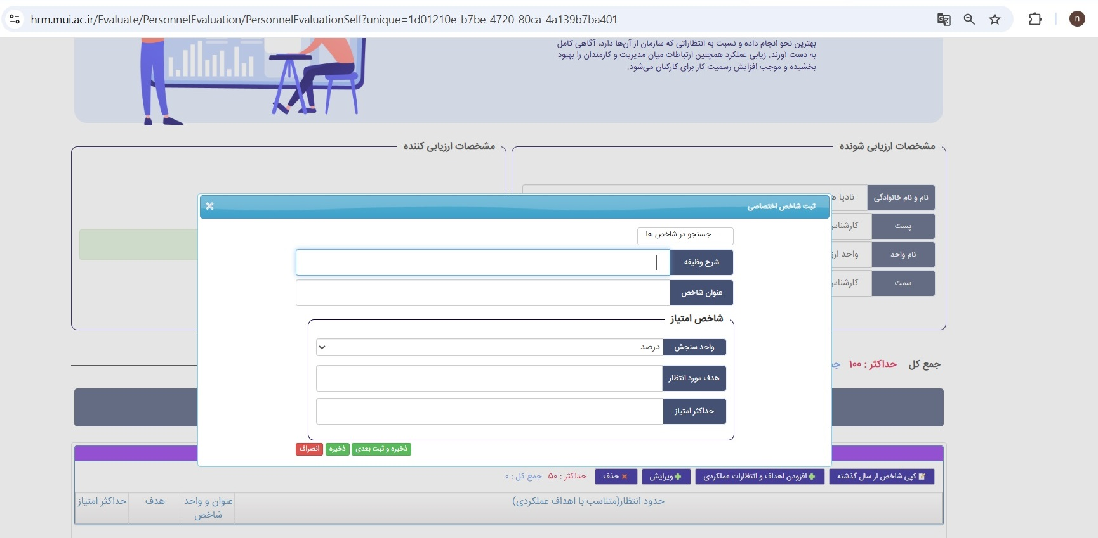
چنانچه سمت شما یا شرح وظایف شما تغییر نموده گزینه " افزودن اهداف و انتظارات عملکردی " را انتخاب نمایید.
You can simply impress your audience and add a unique zing and appeal to your Presentations. Easy to change colors, photos and Text. Get a modern PowerPoint Presentation that is beautifully designed. You can simply impress your audience and add a unique zing and appeal to your Presentations. Easy to change colors, photos and Text. Get a modern PowerPoint Presentation that is beautifully designed.
Modern Portfolio Presentation
در پنجره باز شده هر ردیف را تکمیل و گزینه ذخیره وثبت بعدی را کلیک نمایید. جمع شاخصها باید 50 شود.

Slide 8
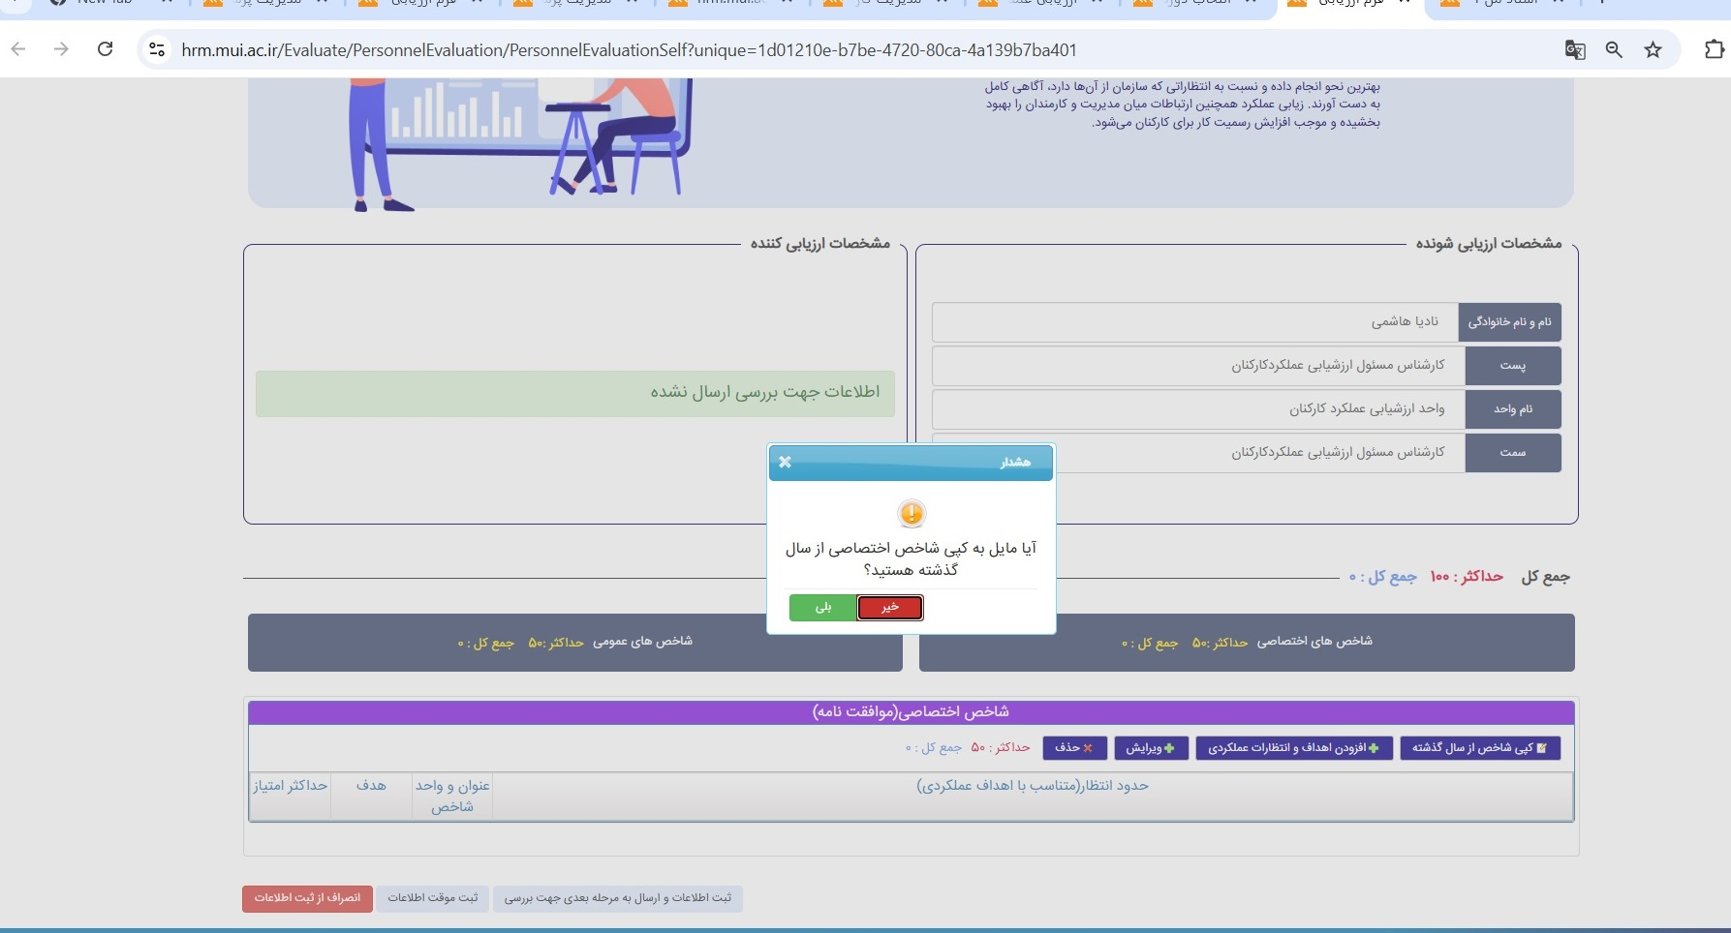
درصورت تمایل و عدم تغییر شاخص های اختصاصی گزینه " کپی شاخص از سال گذشته " را انتخاب نمایید.
You can simply impress your audience and add a unique zing and appeal to your Presentations. Easy to change colors, photos and Text. Get a modern PowerPoint Presentation that is beautifully designed. You can simply impress your audience and add a unique zing and appeal to your Presentations. Easy to change colors, photos and Text. Get a modern PowerPoint Presentation that is beautifully designed.
Modern Portfolio Presentation

Slide 9
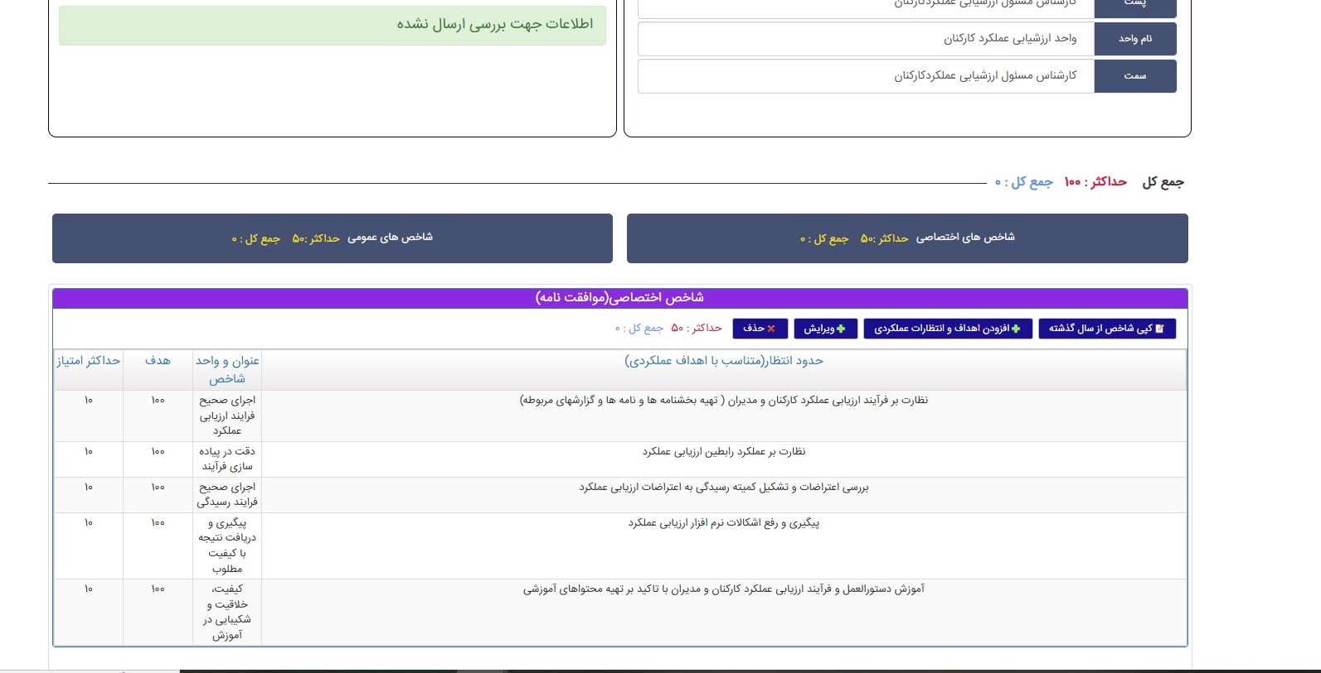
درصورت تایید جهت کپی نمودن ، شاخص های سال 1404 در قسمت شاخص های اختصاصی سال1405 افزوده می شود.
You can simply impress your audience and add a unique zing and appeal to your Presentations. Easy to change colors, photos and Text. Get a modern PowerPoint Presentation that is beautifully designed. You can simply impress your audience and add a unique zing and appeal to your Presentations. Easy to change colors, photos and Text. Get a modern PowerPoint Presentation that is beautifully designed.
Modern Portfolio Presentation

Slide 10
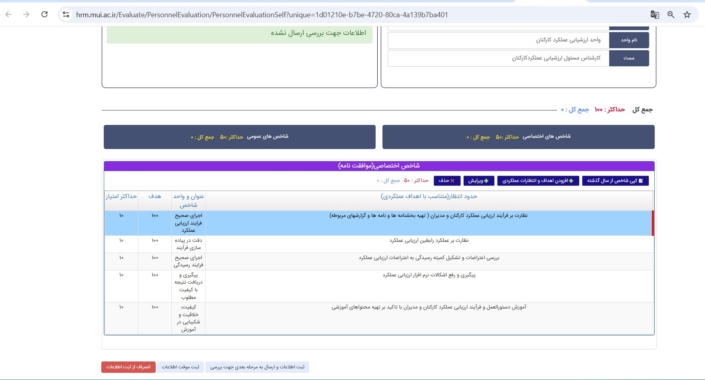
چنانچه شاخصی باید ویرایش شود، ردیف موردنظر را انتخاب و گزینه
" ویرایش" را انتخاب نمایید.
You can simply impress your audience and add a unique zing and appeal to your Presentations. Easy to change colors, photos and Text. Get a modern PowerPoint Presentation that is beautifully designed. You can simply impress your audience and add a unique zing and appeal to your Presentations. Easy to change colors, photos and Text. Get a modern PowerPoint Presentation that is beautifully designed.
Modern Portfolio Presentation

Slide 11
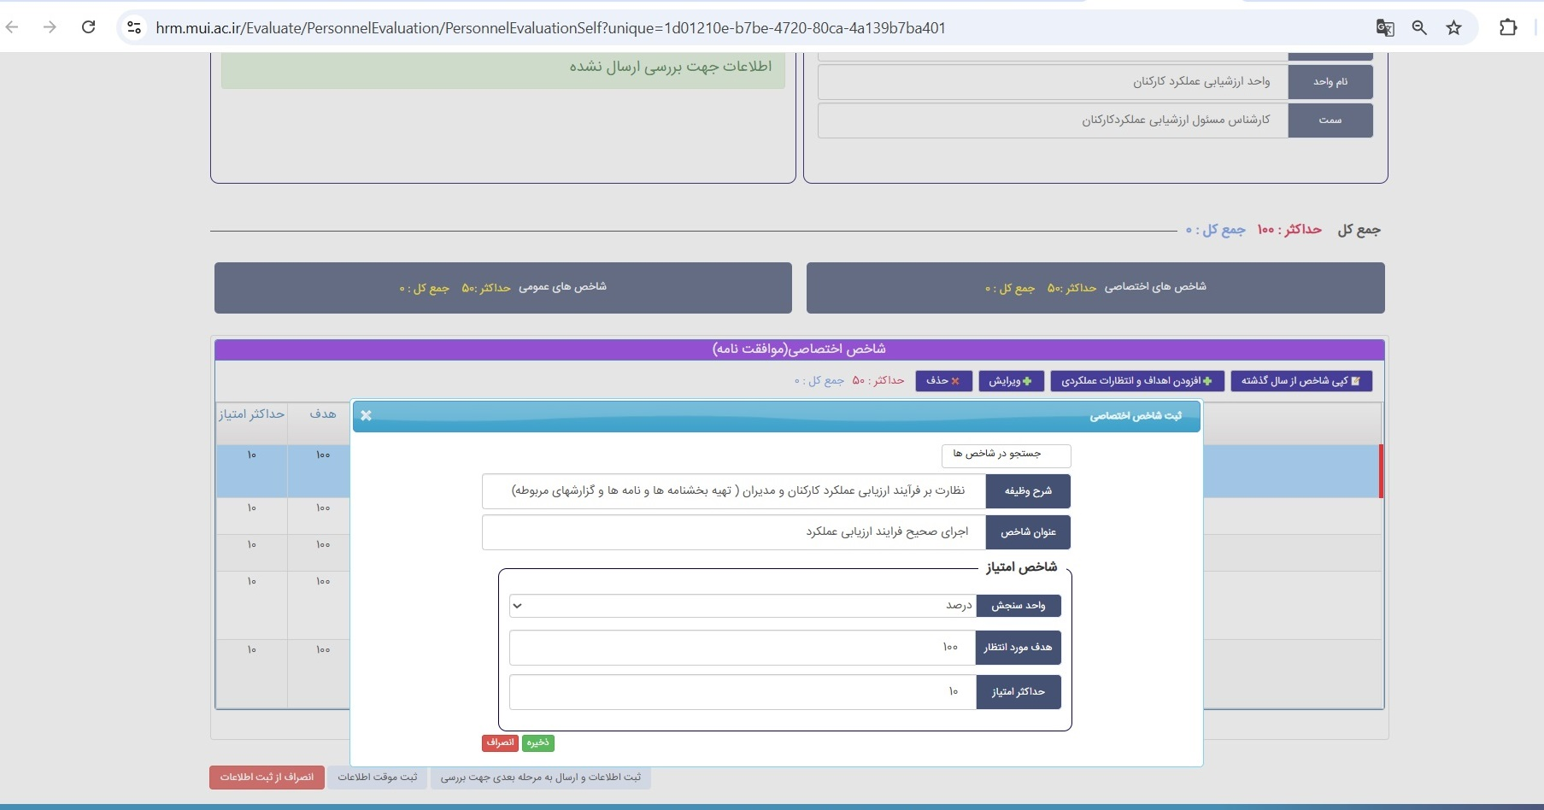
پنجره ای باز می شود. قسمت موردنظر را ویرایش نمایید.
You can simply impress your audience and add a unique zing and appeal to your Presentations. Easy to change colors, photos and Text. Get a modern PowerPoint Presentation that is beautifully designed. You can simply impress your audience and add a unique zing and appeal to your Presentations. Easy to change colors, photos and Text. Get a modern PowerPoint Presentation that is beautifully designed.
Modern Portfolio Presentation

Slide 12
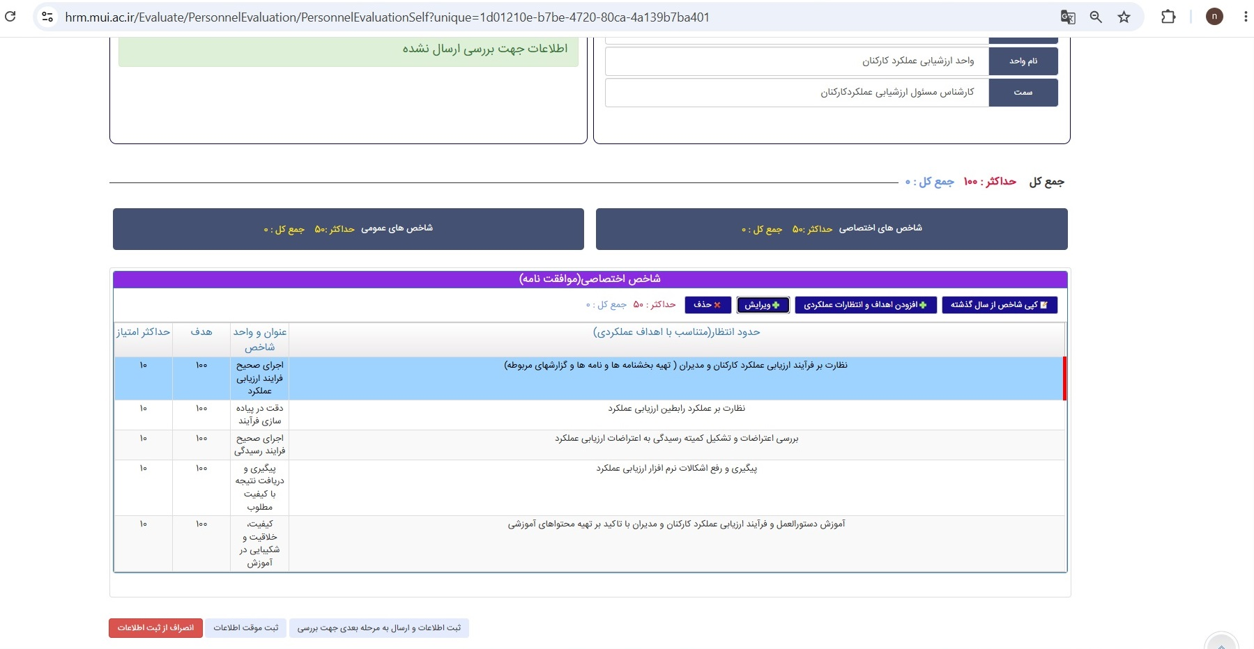
پس از تکمیل شاخصهای اختصاصی ( کپی ، افزودن شاخص ها و یا ویرایش) گزینه " ثبت اطلاعات و ارسال به مرحله بعدی جهت بررسی " را انتخاب نمایید.
You can simply impress your audience and add a unique zing and appeal to your Presentations. Easy to change colors, photos and Text. Get a modern PowerPoint Presentation that is beautifully designed. You can simply impress your audience and add a unique zing and appeal to your Presentations. Easy to change colors, photos and Text. Get a modern PowerPoint Presentation that is beautifully designed.
Modern Portfolio Presentation

Slide 13
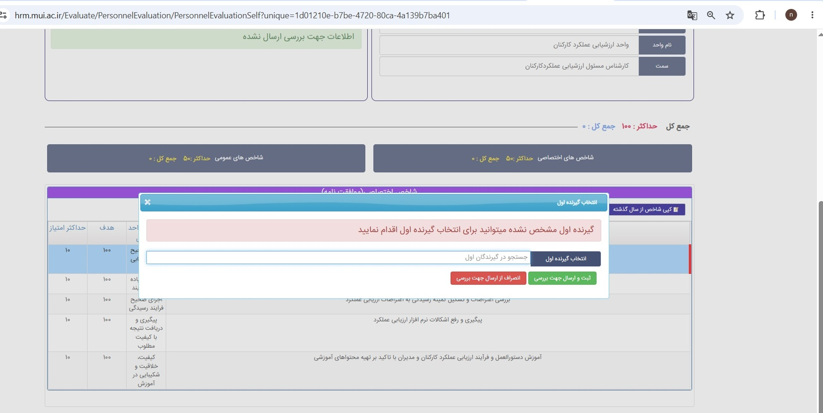
پنجره ای باز می شود. نام ارزیاب را جستجو نمایید.
You can simply impress your audience and add a unique zing and appeal to your Presentations. Easy to change colors, photos and Text. Get a modern PowerPoint Presentation that is beautifully designed. You can simply impress your audience and add a unique zing and appeal to your Presentations. Easy to change colors, photos and Text. Get a modern PowerPoint Presentation that is beautifully designed.
Modern Portfolio Presentation

Slide 14
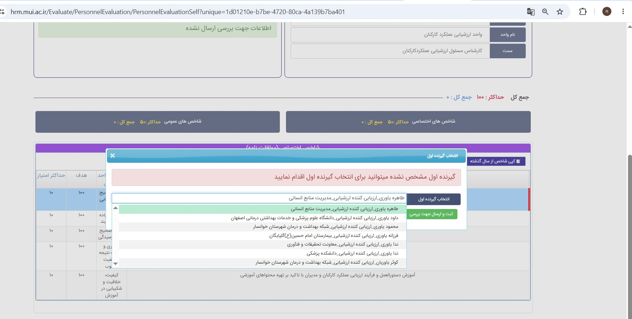
نام ارزیاب را انتخاب نمایید.
You can simply impress your audience and add a unique zing and appeal to your Presentations. Easy to change colors, photos and Text. Get a modern PowerPoint Presentation that is beautifully designed. You can simply impress your audience and add a unique zing and appeal to your Presentations. Easy to change colors, photos and Text. Get a modern PowerPoint Presentation that is beautifully designed.
Modern Portfolio Presentation

Slide 15
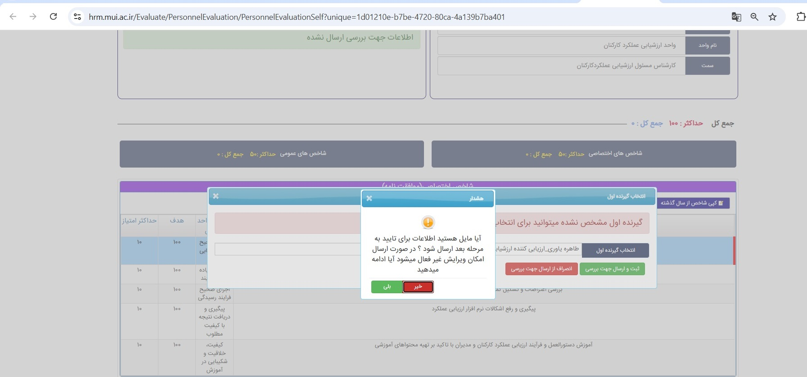
درصورت تایید نام ارزیاب گزینه "بلی" را انتخاب و فرم را به ارزیاب ارسال نمایید.
You can simply impress your audience and add a unique zing and appeal to your Presentations. Easy to change colors, photos and Text. Get a modern PowerPoint Presentation that is beautifully designed. You can simply impress your audience and add a unique zing and appeal to your Presentations. Easy to change colors, photos and Text. Get a modern PowerPoint Presentation that is beautifully designed.
Modern Portfolio Presentation

Slide 16
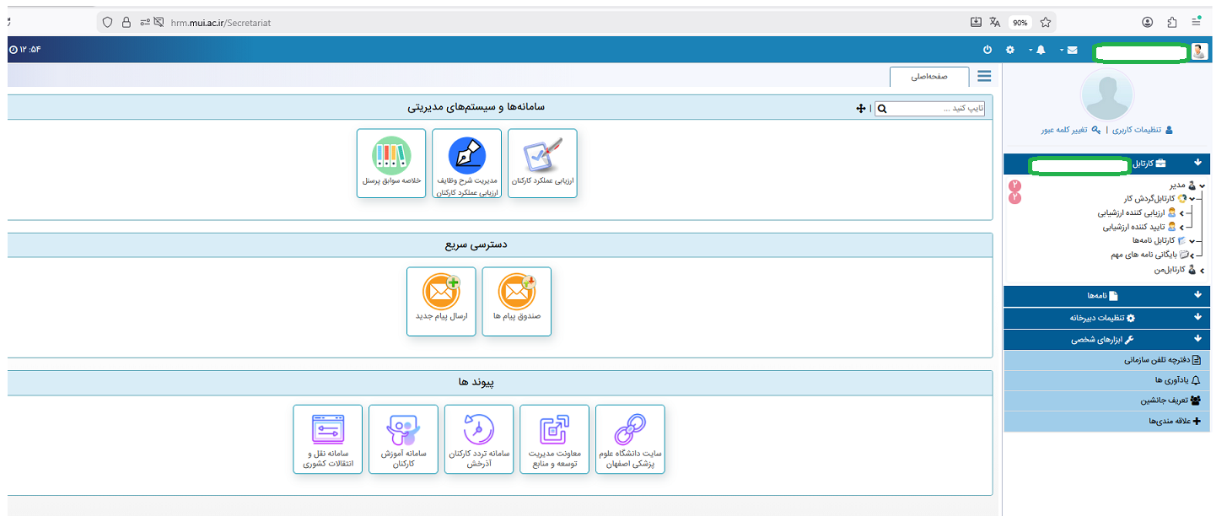
ارزیاب وارد سامانه ارزشیابی شده و قسمت ارزیابی کننده ارزشیابی را انتخاب نماید.

Slide 17
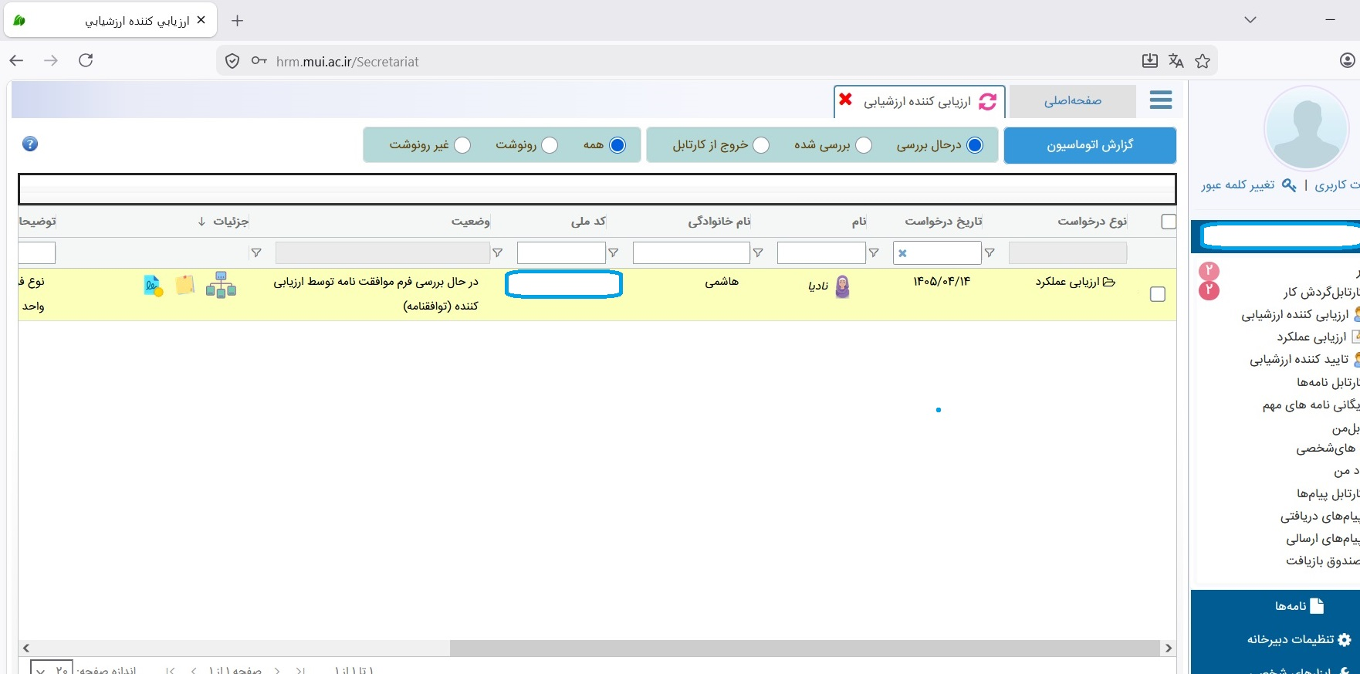
در وسط صفحه افرادی که فرم خود را به
ارزیاب ارسال نموده اند مشاهده می شوند .
You can simply impress your audience and add a unique zing and appeal to your Presentations. Easy to change colors, photos and Text. Get a modern PowerPoint Presentation that is beautifully designed. You can simply impress your audience and add a unique zing and appeal to your Presentations. Easy to change colors, photos and Text. Get a modern PowerPoint Presentation that is beautifully designed.
Modern Portfolio Presentation

Slide 18
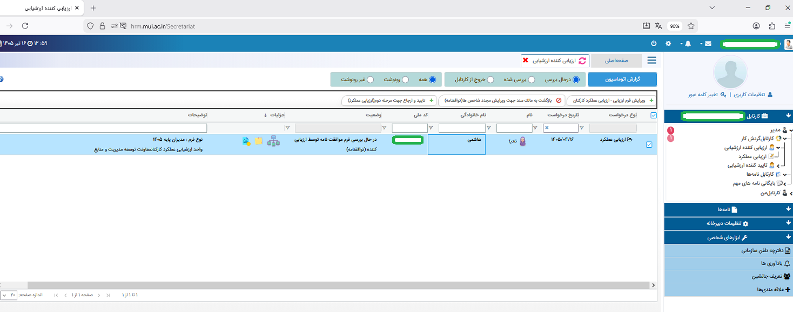
ارزیاب، گزینه " ویرایش فرم ارزیابی - ارزیابی عملکرد کارکنان " را انتخاب نماید.

Slide 19
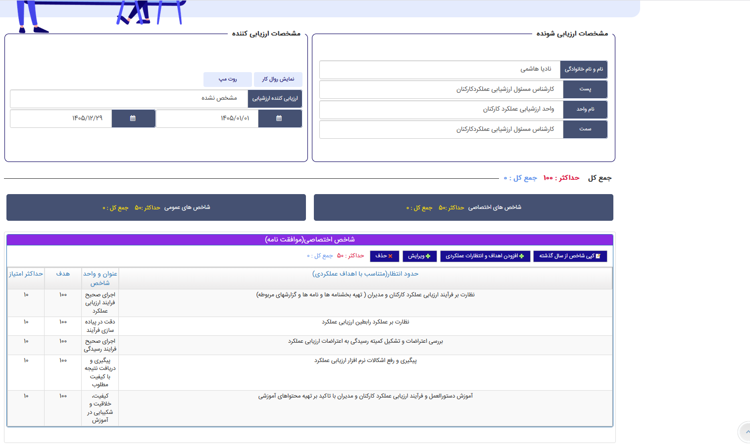
پس از بررسی فرم درصورت تایید، فرم در کارتابل ارزیاب تا زمان شروع مرحله ارزیابی
باقی می ماند.

Slide 20
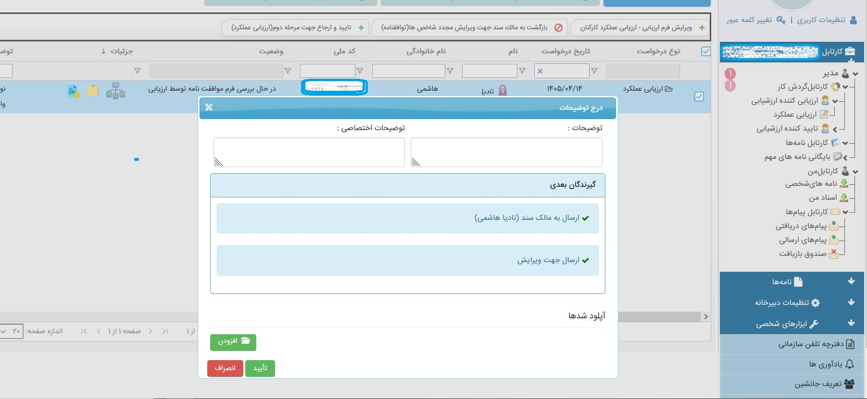
درصورت نیاز به ویرایش به مالک سند ارجاع دهد.
You can simply impress your audience and add a unique zing and appeal to your Presentations. Easy to change colors, photos and Text. Get a modern PowerPoint Presentation that is beautifully designed. You can simply impress your audience and add a unique zing and appeal to your Presentations. Easy to change colors, photos and Text. Get a modern PowerPoint Presentation that is beautifully designed.
Modern Portfolio Presentation

Slide 21
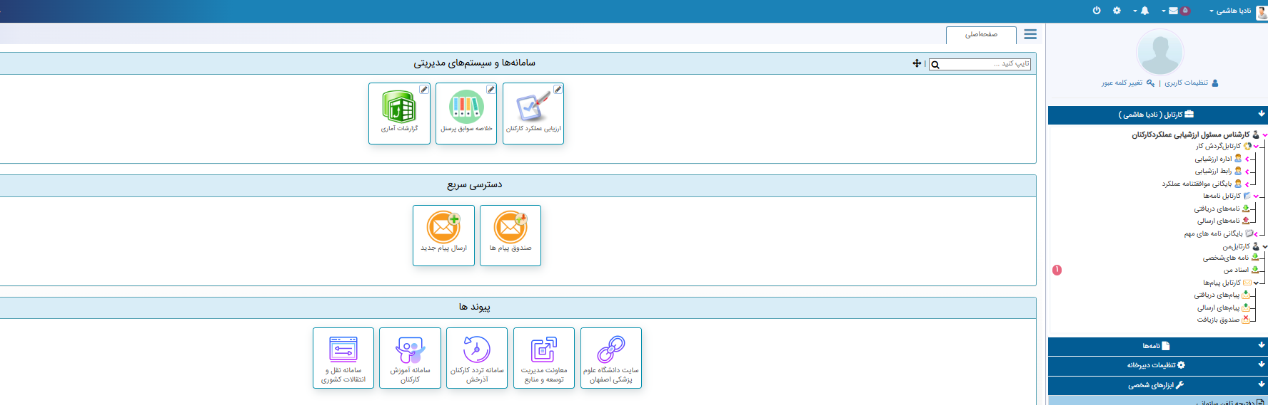
ارزیابی شونده وارد سامانه ارزیابی خود شود.چنانچه کنار گزینه “ اسناد من” عدد مشاهده شود.یعنی در کارتابلش فرمی وجود دارد. .”اسناد من” را انتخاب نماید.
1

Slide 22
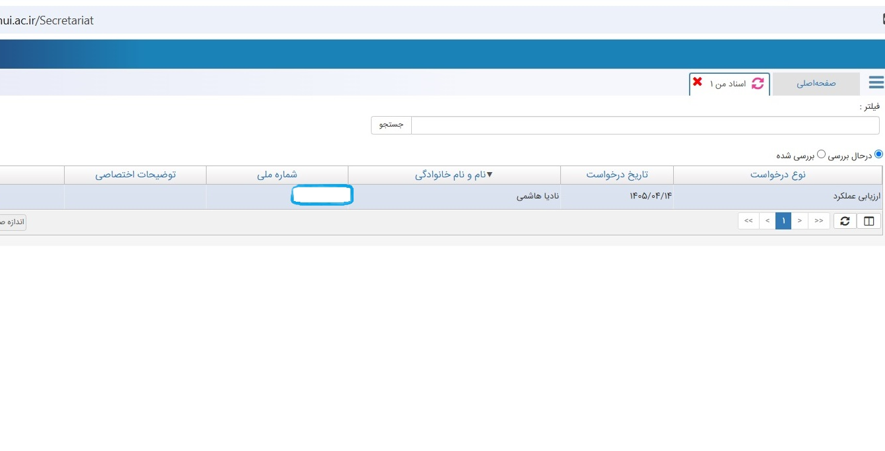
با انتخاب گزینه “ اسناد من”، در وسط صفحه اطلاعات کلی در مورد فرد نشان داده می شود. “
You can simply impress your audience and add a unique zing and appeal to your Presentations. Easy to change colors, photos and Text. Get a modern PowerPoint Presentation that is beautifully designed. You can simply impress your audience and add a unique zing and appeal to your Presentations. Easy to change colors, photos and Text. Get a modern PowerPoint Presentation that is beautifully designed.
Modern Portfolio Presentation

Slide 23
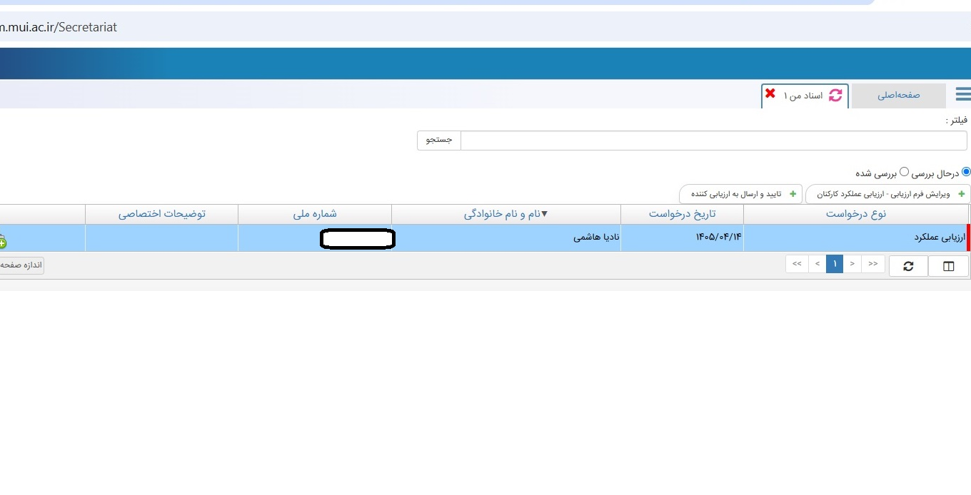
با انتخاب ردیف اطلاعات ، گزینه های بالای ردیف مشخص می شود.
You can simply impress your audience and add a unique zing and appeal to your Presentations. Easy to change colors, photos and Text. Get a modern PowerPoint Presentation that is beautifully designed. You can simply impress your audience and add a unique zing and appeal to your Presentations. Easy to change colors, photos and Text. Get a modern PowerPoint Presentation that is beautifully designed.
Modern Portfolio Presentation

Slide 24
با انتخاب ردیف اطلاعات ، گزینه های بالای ردیف مشخص می شود.
You can simply impress your audience and add a unique zing and appeal to your Presentations. Easy to change colors, photos and Text. Get a modern PowerPoint Presentation that is beautifully designed. You can simply impress your audience and add a unique zing and appeal to your Presentations. Easy to change colors, photos and Text. Get a modern PowerPoint Presentation that is beautifully designed.
Modern Portfolio Presentation
با انتخاب گزینه” ویرایش ارزیابی- ارزیابی عملکرد کارکنان” و مشاهده فرم، تغییراتی که با توافق با ارزیاب، موردنیاز می باشد، اعمال می گردد.

Slide 25
با انتخاب گزینه” ویرایش ارزیابی- ارزیابی عملکرد کارکنان” و مشاهده فرم، تغییراتی که با توافق با ارزیاب، موردنیاز
می باشد، اعمال می گردد.
You can simply impress your audience and add a unique zing and appeal to your Presentations. Easy to change colors, photos and Text. Get a modern PowerPoint Presentation that is beautifully designed. You can simply impress your audience and add a unique zing and appeal to your Presentations. Easy to change colors, photos and Text. Get a modern PowerPoint Presentation that is beautifully designed.
Modern Portfolio Presentation

Slide 26
بپس از ویرایش فرم .ثبت موقت در پایین فرم را انتخاب نموده و مجدد وارد این صفحه شوید.گزینه “ تایید و ارساال به ارزیاب کننده “ را انتخاب نمایید.
You can simply impress your audience and add a unique zing and appeal to your Presentations. Easy to change colors, photos and Text. Get a modern PowerPoint Presentation that is beautifully designed. You can simply impress your audience and add a unique zing and appeal to your Presentations. Easy to change colors, photos and Text. Get a modern PowerPoint Presentation that is beautifully designed.
Modern Portfolio Presentation

Slide 27
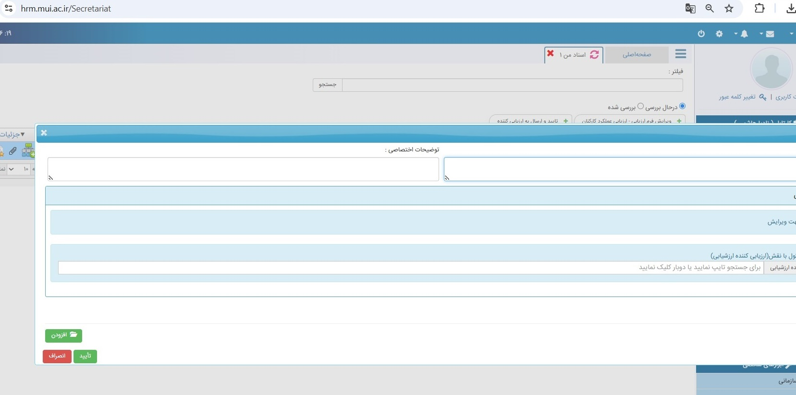
با انتخاب گزینه “ تایید و ارسال به ارزیاب کننده “
پنجره ای باز می شود، نام ارزیاب را تایپ و گزینه
” تایید” را انتخاب نمایید.
You can simply impress your audience and add a unique zing and appeal to your Presentations. Easy to change colors, photos and Text. Get a modern PowerPoint Presentation that is beautifully designed. You can simply impress your audience and add a unique zing and appeal to your Presentations. Easy to change colors, photos and Text. Get a modern PowerPoint Presentation that is beautifully designed.
Modern Portfolio Presentation

Slide 28
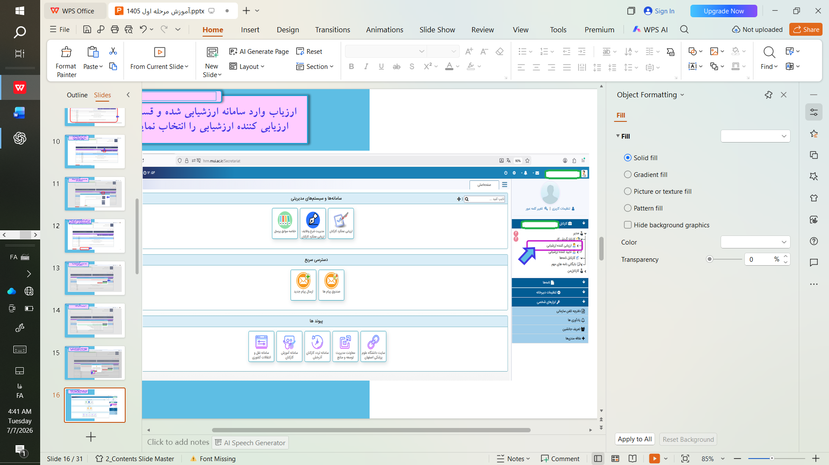
فرمهای ارزیابی تا زمان شروع مرحله ارزیابی، در کارتابل ارزیابی کننده باقی می ماند.
پس از ارسال فرم های ارزیابی به کارتابل ارزیابی کننده، مرحله
ثبت وقایع حساس در قسمت
“ مدیریت شرح وظایف ارزیابی عملکرد کارکنان” در کارتابل
ارزیابی کننده، فعال می شود.

Slide 29

«ارزشیابی، نه برای یافتن خطا، بلکه برای ترسیم مسیر رشد است.»
تیر ماه 1405

